Slide 1
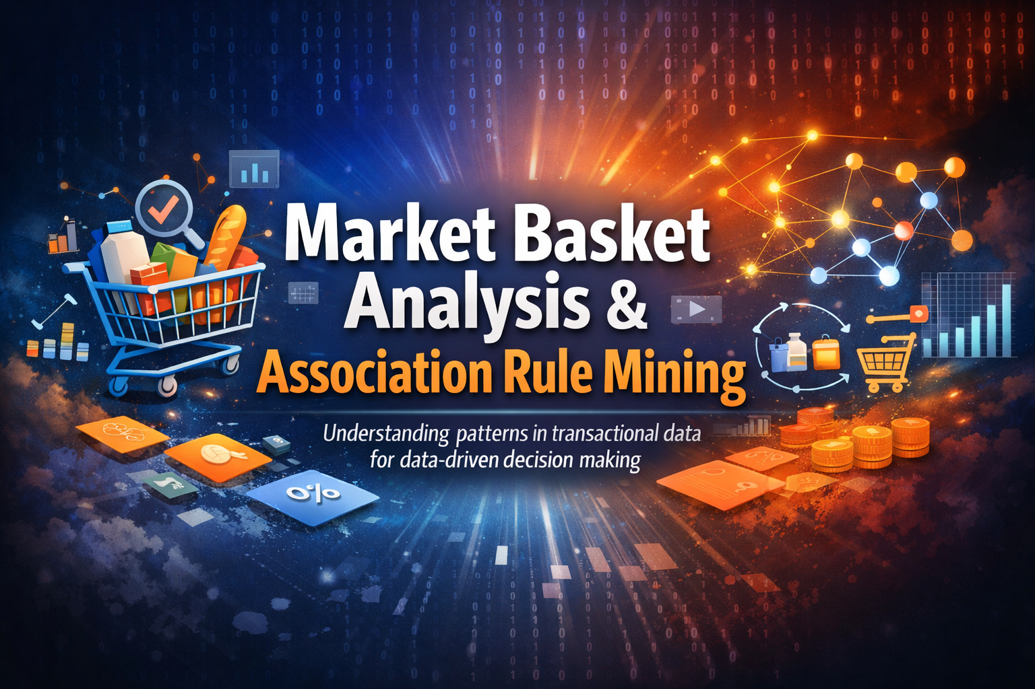
Market Basket Analysis & Association Rule Mining
Understanding patterns in transactional data for
data-driven decision making
Prepared by:
Divya Tripathi
(RA2311003030547)
BTECH CSE CORE – I
(3rd Year/6th semester)

Slide 2

What is Market Basket Analysis?
Market Basket Analysis examines to identify patterns in transactional data. This technique discovers relationships between items frequently purchased together, enabling businesses to make informed decisions about promotions, product placement, and cross-selling strategies.
By analysing vast amounts of transaction data, organisations can uncover hidden associations that drive strategic marketing initiatives and optimise retail operations.

Slide 3
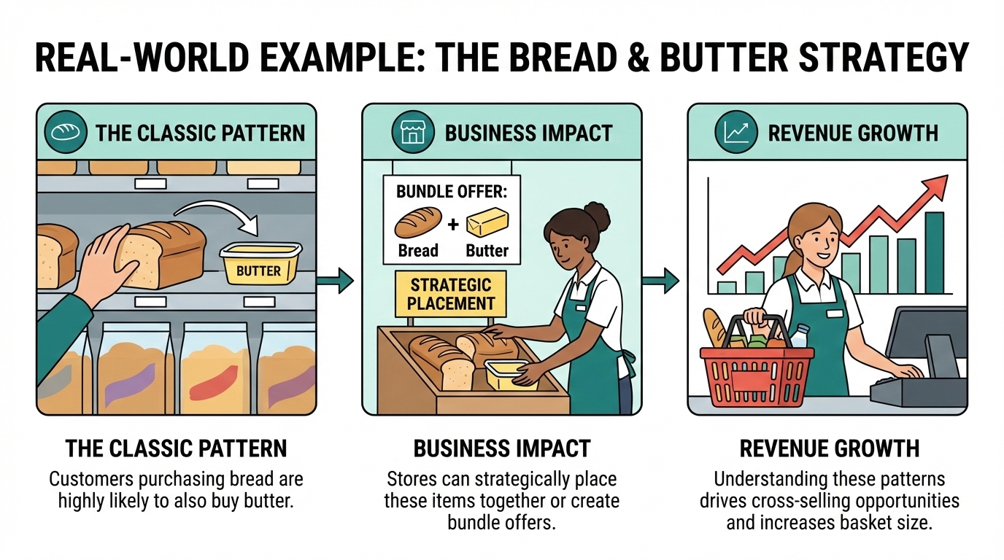




Real-World Example
The Classic Pattern
Customers purchasing bread are highly likely to also buy butter
Business Impact
Revenue Growth
Data Insight/ Analytics Value
Association rules quantify relationships
using support, confidence, and lift—
helping businesses make data-driven
decisions
Stores can strategically place these items together or create bundle offers
Understanding these patterns drives cross-selling opportunities and increases basket size

Slide 4





The Apriori Algorithm
The classic approach to mining frequent itemsets through iterative candidate generation and pruning
Candidate Generation
Support Counting
Creates k-itemsets from (k-1)-itemsets
Calculates support for each candidate
Pruning
Rule Generation
Removes infrequent itemsets
Extracts association rules
Key Metrics: Support measures itemset frequency whilst confidence indicates rule reliability

Slide 5
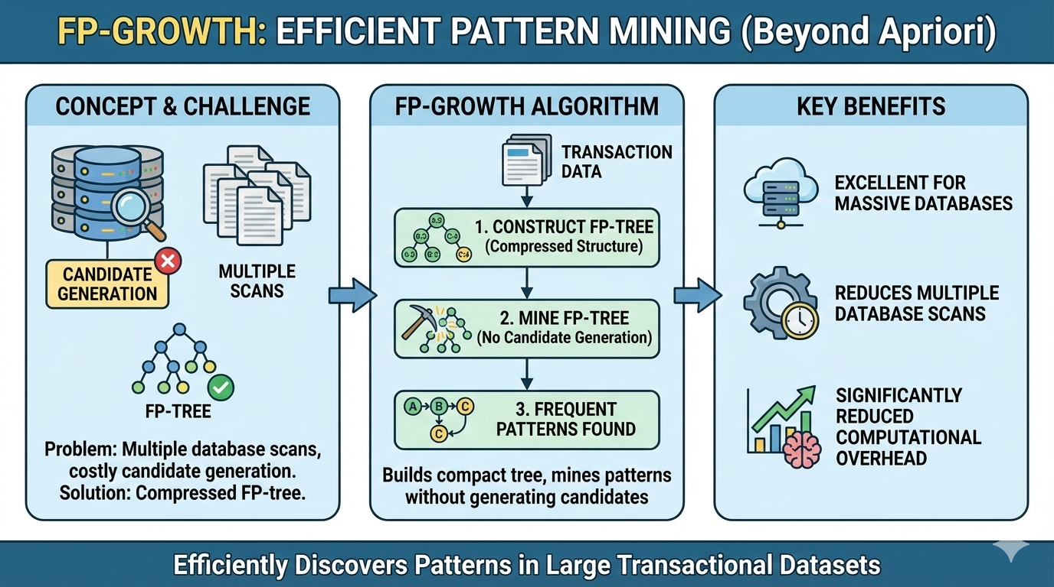
FP-Growth: Efficient Pattern Mining
Beyond Apriori
The FP-Growth algorithm eliminates candidate generation by constructing a compressed FP-tree structure. This approach is particularly effective for large datasets, significantly reducing computational overhead.
Builds compact tree representation
Mines patterns without candidate generation
Excellent for massive transaction databases
Reduces multiple database scans

Slide 6
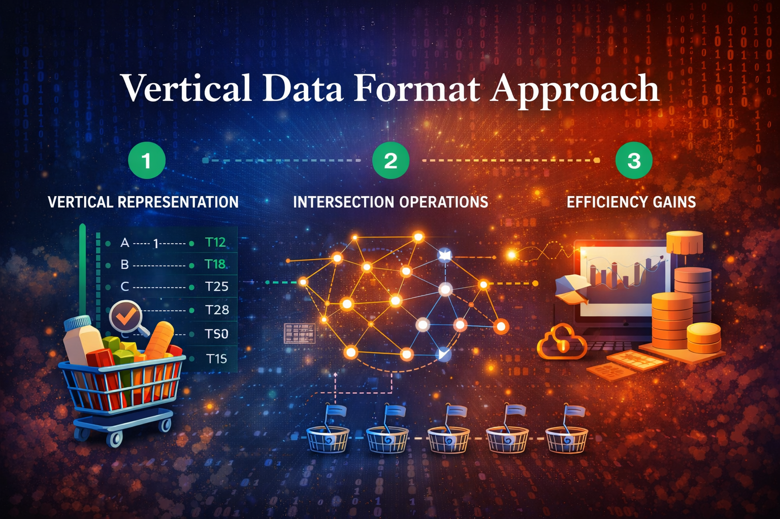
Vertical Data Format Approach
1
2
3
Vertical Representation
Intersection Operations
Efficiency Gains
Each item maps to a set of transaction IDs (TIDs) where it appears
Frequent itemsets found by intersecting TID lists of constituent items
Reduces database scans and improves computational performance

Slide 7
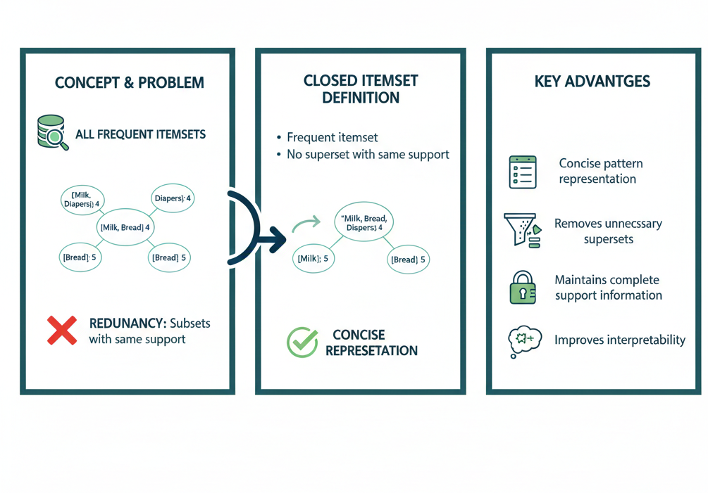
Closed Frequent Itemsets
Eliminating Redundancy
Closed itemsets are frequent itemsets with no superset having identical support. This concept reduces pattern redundancy whilst maintaining complete information about all frequent patterns.
Advantages:
Concise pattern representation
Removes unnecessary supersets
Maintains complete support information
Improves interpretability

Slide 8



Multilevel Association Rules
Mining rules at different levels of abstraction using concept hierarchies
Product Level
Subcategory Level
Gaming Laptops
Category Level
Laptops
Electronics
Hierarchical structures enable discovery of patterns at varying granularities, from broad categories to specific products, providing flexible insights for different business needs.

Slide 9

Multidimensional & Correlation Analysis
Multidimensional Rules
Correlation Metrics
Rules involving multiple attributes beyond purchased items
Measures association strength beyond support and confidence
Lift, Conviction, Pearson correlation
Example: {Age: 20–30, Gender: Male} → Buys: Video Games
True Relationships
Identifies genuinely related items rather than coincidental co-occurrence

Slide 10
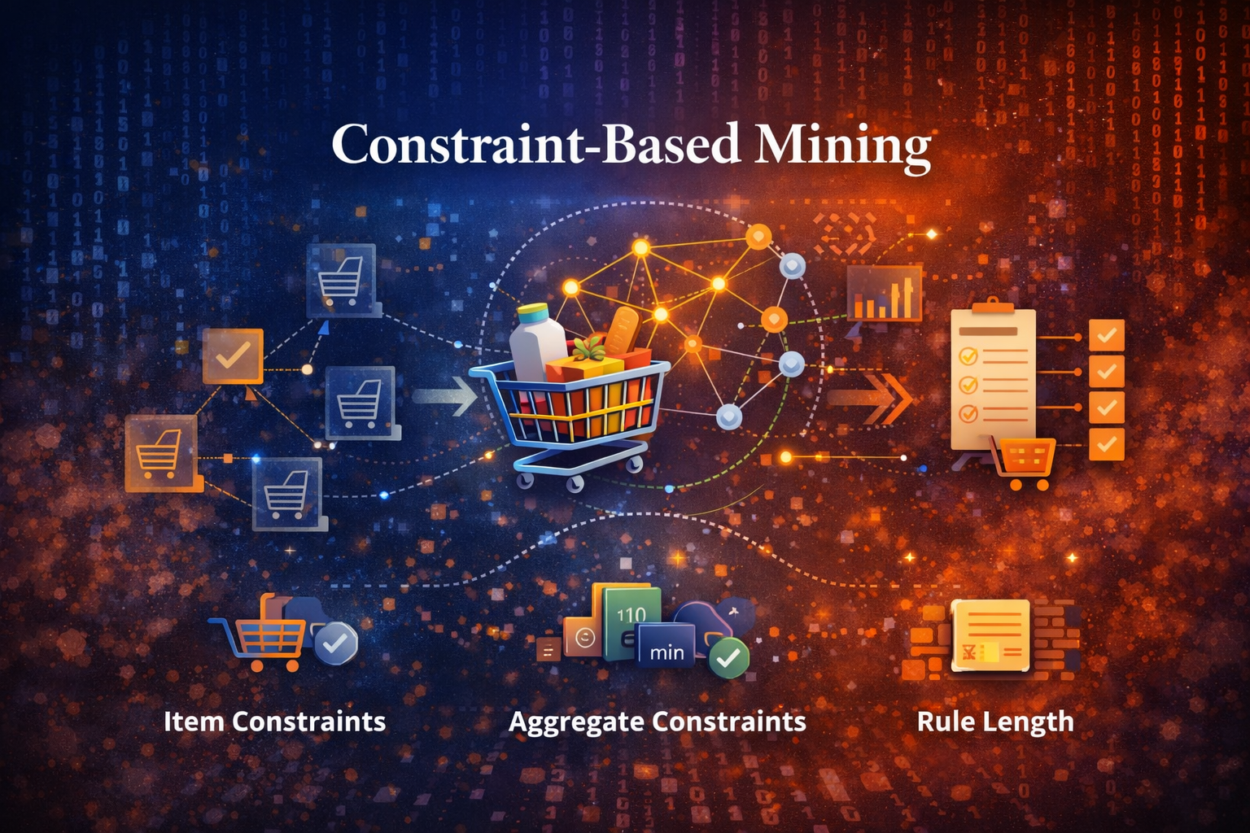
Constraint-Based Mining
Targeted Pattern Discovery
Applies to focus mining efforts on actionable, relevant patterns.
This approach reduces computational burden whilst
increasing business value.
Identifies hidden relationships between items in
transactional data.
Helps businesses optimize product placement
and promotions.
Supports data driven decision making using
association rules.
Reduces search space by applying user defined
constraints.
Improves efficiency by filtering out irrelevant
patterns early.
Item Constraints
Aggregate Constraints
Rule Length
Specific items or categories of interest
Minimum/maximum values for support or other metrics
Limits number of items in generated rules

Slide 11


